Slide 1
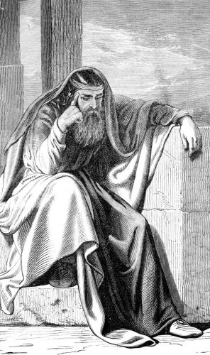
Ezekiel the Prophet
"Go to the exiles, to the sons of your people, and speak to them and tell them, whether they listen or not, 'Thus says the Lord GOD.'"
(Ezekiel 3:11)
“So the Spirit lifted me up and took me away; and I went embittered in the rage of my spirit, and the hand of the LORD was strong on me. Then I came to the exiles who lived beside the river Chebar at Tel-abib, and I sat there seven days where they were living, causing consternation among them.”
(Ezekiel 3:14-15)

Slide 3
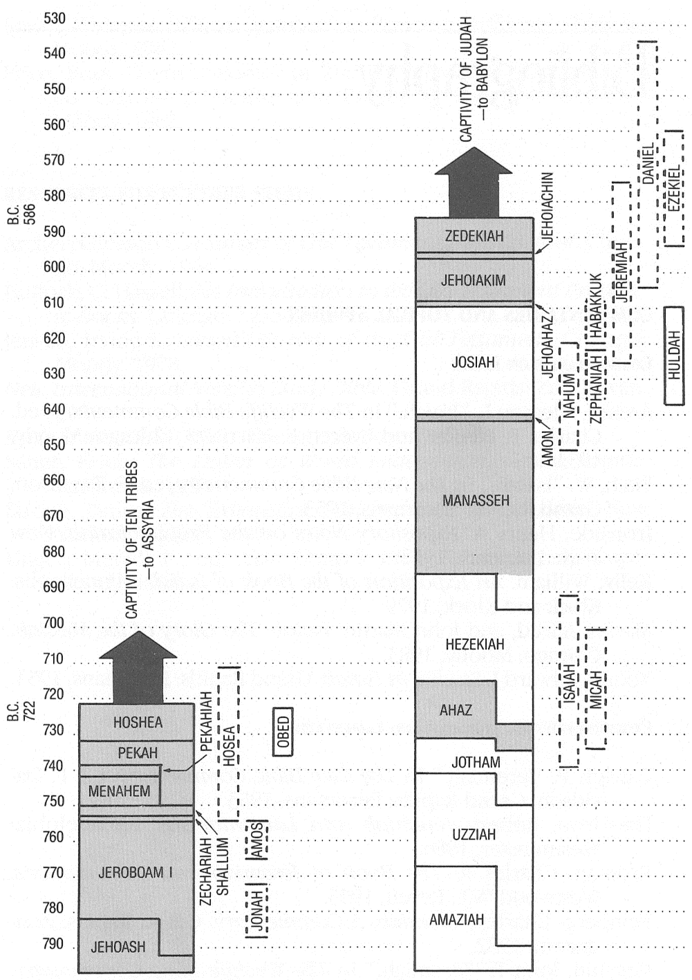
Chart of Kings and Prophets

Slide 4
Chart of Kings and Prophets

Slide 5
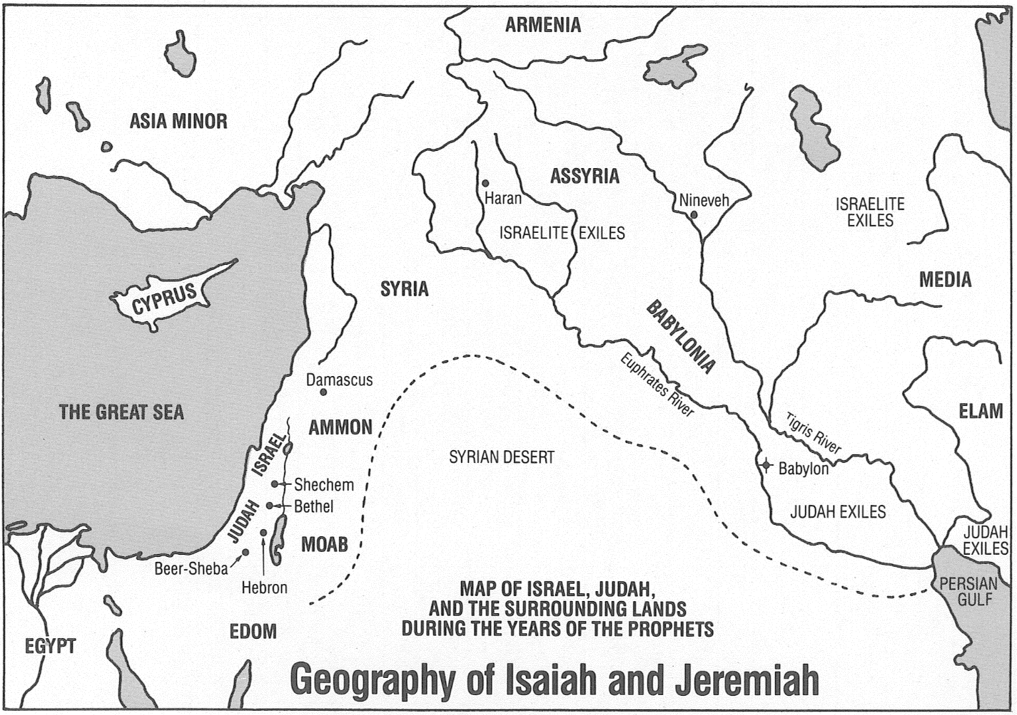

Slide 6
Historical Background of Ezekiel
(Same as Jeremiah)
2 Kings 21-25
2 Chronicles 33-36
"I will make them an object of horror among all the kingdoms of the earth because of Manasseh, the son of Hezekiah, the king of Judah, for what he did in Jerusalem." (Jeremiah 15:4)

Slide 7
Historical Background of Ezekiel
2 Kings 21-25 (The bad, the bad and the Reformer…)
King Manasseh’s Evil Reign (21:1-9) approx. 697-642 BC
God pronounces destruction on Judah (21:10-16)
King Amon is also evil and is killed (21:19-26)
King Josiah seeks God, rebuilds the temple,
finds the book of the law (22:1-11)
King Josiah inquires of God (22:12-20)
King Josiah’s Reforms (23:1-27)

Slide 8
Historical Background of Ezekiel
2 Kings 21-25 (Judah Loses Control)
King Josiah dies in battle (23:28-30)
King Jehoahaz reigns briefly and wickedly
till imprisoned by Pharaoh Neco (23:31-33)
Jehoiakim made king by Pharaoh, paid tribute
to Egypt and was wicked (23:34-37)
Jehoiakim switches to Nebuchadnezzar of Babylon and then rebels (24:1)

Slide 9
Historical Background of Ezekiel
2 Kings 21-25 (God Brings Destruction/Captivity)
God sends the Babylonians and others against Judah (24:2-4)
Evil King Jehoiachin briefly reigns. Egypt declines as a power. Babylon expansive (24:6-9)
Babylon lays siege to Jerusalem. Takes captives away to Babylon. 597 BC (24:10-16)
Zedekiah made King in Judah, is wicked and rebels against Babylon (24:17-20)

Slide 10
Historical Background of Ezekiel
2 Kings 21-25 (God Brings Destruction/Captivity)
Babylon lays siege to Jerusalem and ultimately destroys the city. Destroys walls and Temple. More captives to Babylon. 586 BC (25:1-21)
Nebuchadnezzar appoints Gedaliah governor over the remains of Judah, he is killed, the people flee to Egypt fearful of Babylon taking Jeremiah the prophet with them. (25:22-30)

Slide 11
Certain Judgment Coming
2 Ki 21:10-15 Judgment Announced
2 Ki 22:13, 16-17 “will not be quenched”
2 Ki 22:18-20 Wrath only “postponed” due to Josiah
2 Ki 23:26-27 God did not “turn from” His great wrath
2 Ki 24:2-3 God sends “punishers”
2 Ki 24:20 through the anger of the Lord
2 Ki 25:21 “So Judah was led away”
2 Chron 36:16 “until there was no remedy”

Slide 12
Ezekiel: The Man
Ezekiel at age 30 begins his work “On the fifth of the month in the fifth year of King Jehoiachin’s exile” or about 593 BC (Ezekiel 1:1-2) He continues his work thru at least his 52nd year (571 BC)
Ezekiel was of a priestly family.
Ezekiel was married!
God refers to her as “the desire of your eyes” suggesting a warm and tender relationship.
No mention of children.
Ezekiel’s wife dies in the 9th year of his captivity, 4 years after he began his ministry. (Ezekiel 24)

Slide 13
Ezekiel’s Ministry
Ezekiel was among the 2nd wave of captives (The King plus 10,000 leading citizens) taken to Babylon in 597 BC.
Contemporary of Jeremiah, but never mentions him.
Contemporary of Daniel and mentions him 3X (14:4, 20; 28:3)
Prophet to the captives in Babylon.
His ministry can be divided into two distinct phases:
The Prophet of Doom prior to the fall of Jerusalem (593-587)
The Prophet of Hope, rebuilding the captive’s faith (587-571)
Preaching, Visions, Symbolic Actions are all very prominent.

Slide 14
The Structure of Ezekiel
Ezekiel Chapters 1-23
Oracles concerning “Israel” (God’s people)
Prior to the fall of Jerusalem
Theme: Condemnation and Catastrophe
Ezekiel Chapters 25-32
Oracles concerning foreign nations
During the siege of Jerusalem
Ezekiel Chapters 33-49
Oracles concerning Israel
After the fall of Jerusalem
Theme: Consolation and Comfort.

Slide 15
Themes Found in Ezekiel
CONCERNING GOD:
God is GOD! (1:18, 24)
God rules over ALL men and nations.
God is HOLY and Just (36:20-23; 39:7,25)
A holy God can not overlook sin.
A Holy God can not dwell with sin (10:18; 11:23)
God is Gracious (18:23, 32; 33:11)
In the midst of threats, He encourages His people to repent (14:22; 16:63; 20:11)
Though His people were undeserving of mercy (36:32), He promised them a glorious future.

Slide 16
Themes Found in Ezekiel
CONCERNING MAN:
Man is God’s creature and property (18:4)
Original innocence of man (28:15, 17)
Man makes a choice to be sinful (18:21-30)
Individual Accountability (18:4, 13, 18)
Man can choose to be righteous (33:11; 43:9)
To those individuals willing to receive it, God would give a “new heart” (11:19-21; 37:23)

Slide 17
Themes Found in Ezekiel
The Messiah:
Ezekiel presents the coming one as a faithful prince among God's restored people, their true and faithful shepherd and King.
Not as “messianic” as Isaiah but clearly taught.
The Kingdom of God:
The term “Kingdom of God” does not appear in the book.
Yet, Ezekiel clearly teaches the concept of God’s reign over the hearts of redeemed people wherever they may be…

